Slide 1
Hyperspectral Rendering in Radiance
Greg Ward, Anyhere Software

Slide 2
Talk Outline
Introduction and context
New Radiance primitives
New rendering parameters
Radiance tools for hyperspectral
Example scene with comparisons
Discussion and future outlook
Conclusion

Slide 3
What Is Radiance?
“Radiance” is a software package first developed in the late 1980’s and still in use by building researchers and designers today
Radiance is a unit of light flux measurement (watts/steradian-meter² in SI units)
Spectral radiance subdivides light over multiple wavelengths

Slide 4
Radiance Rendering

Slide 5
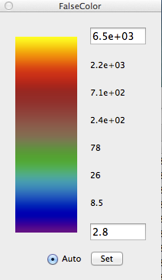
Corresponding Luminance

Slide 6
What Is Hyperspectral?
Traditional rendering uses RGB to represent color values
3x3 matrix to CIE XYZ colorimetry
Hyperspectral rendering divides spectrum into >3 (typically ≥9) bands
Spectral limits may exceed those of human visual response (IR, UV)
More accurate with new applications

Slide 7
Current Impetus
Many researchers and practitioners are concerned with melanopic response
melanopic ≠ photometric sensitivity
distrust of approximations from RGB
Active research in terrestrial solar and sky spectra
Current methods mostly retrace rays using Radiance

Slide 8
Advantages of Native Hyperspectral Rendering
More efficient, since rays do not need to be stored or retraced
Retracing rays also leads to chromatic noise due to non-repeating ray trees
New HSR (hyperspectral radiance) image format introduced
new tools for HSR display and calcs

Slide 9
Sensitivity Curves
Melanopic
Scotopic
Photopic

Slide 10
Radiance System Design
Scene format has 3-component colors baked into material primitive types
Initially contemplated redesign of scene description based on “Materials and Geometry Format” (MGF)
would have required full rewrite of existing rendering code
MGF colors covers visible spectrum only

Slide 11
Hyperspectral Extensions
While Radiance material types only support 3 spectral samples, new pattern primitives are multi-spectral:
“spectrum” is a basic spectral color
“specfile” takes static spectrum from file
“specfunc” is dynamic and procedural
“specdata” is dynamic and data-driven
“specpict” maps a hyperspectral image

Slide 12
How Spectral Patterns Work
Depending on the primitive it modifies, a spectral pattern typically multiplies a material’s RGB color to determine reflectance or transmittance
Multiplication rules are based on “partition” wavelengths that define RGB bands

Slide 13
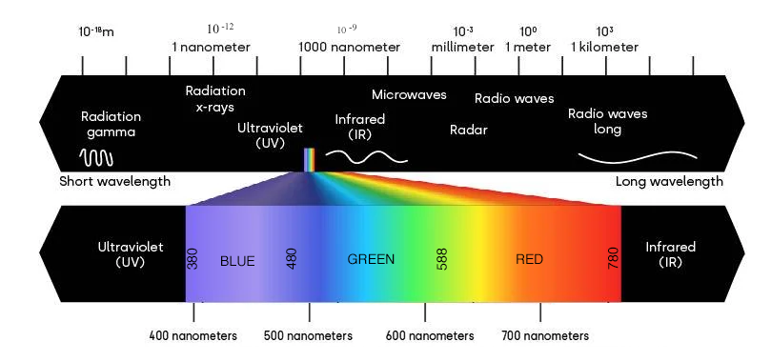
Partitioning the Spectrum
Spectrum is partitioned into wavelengths of 380-480nm for BLUE, 480-588nm for GREEN, and 588-780nm for RED for purposes of multiplication between material colors and spectral patterns
Extrema may be adjusted to cover UV and/or IR if desired, which does not alter the range of GREEN, only BLUE and RED
The number of spectral samples may be set from 3 to MAXCSAMP (24 in 6.0a prerelease)

Slide 14
Example Spectrum
void spectrum gold_spec
0
0
82 380 775 0.389133964 0.389133964 0.389255302 0.389980986 0.391051245
0.392138273 0.392908482 0.393032534 0.392429968 0.391351324
0.390030615 0.388650157 0.387407915 0.386320218 0.385530031
0.385510124 0.386040307 0.386026057 0.388298949 0.394215681
0.404140535 0.419966115 0.443246002 0.473861019 0.511014174
0.552643396 0.596304788 0.639685049 0.682955923 0.723645597
0.759200442 0.789126545 0.813469177 0.832955943 0.848265499
0.860485356 0.870549939 0.878925721 0.885276016 0.891159039
0.896546999 0.901393946 0.905636686 0.909327028 0.912475235
0.91521538 0.917680109 0.919998384 0.922297675 0.924966158
0.927728576 0.930571538 0.933477024 0.936421086 0.939377245
0.942439249 0.945588396 0.948563802 0.951319598 0.953828111
0.956075841 0.958059262 0.959789105 0.961306963 0.96261608
0.963753124 0.964748535 0.965627808 0.966413149 0.96712339
0.967778124 0.968398351 0.968976934 0.969517604 0.970024269
0.970500409 0.970949021 0.971372989 0.971775043 0.972157635
gold_spec metal gold_smat
0
0
5 1 1 1 1 0
Starting λ
Ending λ
Multiplies spectrum
Notes:
Spectral patterns accept whatever sampling you provide, then (usually) resample to fit active rendering parameters.

Slide 15
New Rendering Parameters
Supported by all renderers (rpict, rvu, rtrace, & rcontrib):
-cs N # number of spectral samples (default is 3)
-cw w1 w2 # spectrum equally divided from w1 to w2 (nm)
Supported by rpict and rtrace:
-pRGB # output RGB color space (default)
-pXYZ # output XYZ color space
-pc xr yr xg yg xb yb xw yw # output custom color space
Supported by rtrace only:
-pY # output single-channel photopic luminance
-pS # output single-channel scotopic luminance
-pM # output single-channel melanopic luminance
-co+ # output N-channel spectral color (also rtpict)
Note: rcontrib always produces full spectral output based on -cs
Notes:
Default wavelength limits are 380 - 780 nm.

Slide 16
New HSR Image Format
HSR for “Hyperspectral Radiance” uses similar common-exponent encoding to RGBE and XYZE (i.e., HDR format)
Can be produced by rtrace, rcontrib, or rtpict
Can be used by “specpict” primitive
Can be manipulated by pfilt, rcode2bmp, rcomb, rcrop, and rmtxop tools

Slide 17
Example with rtpict & rcomb
Render a hyperspectral image with rtpict and anti-alias with pfilt:
rtpict -vf myview.vf -x 2048 -y 2048 -cs 18 -co+ specscene.oct \
| pfilt -1 -x /2 -y /2 -r .6 > specim.hsr
Convert result to RGB image and melanpopic pixel array using rcomb:
rcomb specim.hsr -c RGB -fc > rgbim.hdr
rcomb specim.hsr -c M -ff > melim.mtx
Tone-map result into 24-bit BMP image:
rcode2bmp specim.hsr
(open “specim.bmp”)

Slide 18
New rcomb Tool
rcomb sits halfway between rmtxop, which performs matrix operations, and pcomb, which combines HDR images
Less memory for supported operations
i.e., everything but transpose operation or concatenating more than two matrices
can stream inputs with ∞ rows
Programmable like pcomb, but for matrix and HSR input and output

Slide 19
Example Spectral Scene
Fluorescent
Red
Neutral.8
Blue
Gold
BlueFlower
MacBeth Colors

Slide 20
MacBeth Reflectance Spectra

Slide 21
Fluorescent Lamp Spectrum

Slide 22
Error from Rendering in RGB

Slide 23
RGB Rendering

Slide 24
Reference Solution (81 spectral samples)

Slide 25
Rendering with 6 Spectral Samples

Slide 26
Error with 6 Spectral Samples
Notes:
Worse due to advantage of rendering in color space related to eye’s effective response

Slide 27
9 Spectral Sample Error

Slide 28
12 Spectral Sample Error

Slide 29
15 Spectral Sample Error

Slide 30
18 Spectral Sample Error

Slide 31
21 Spectral Sample Error

Slide 32
24 Spectral Sample Error

Slide 33
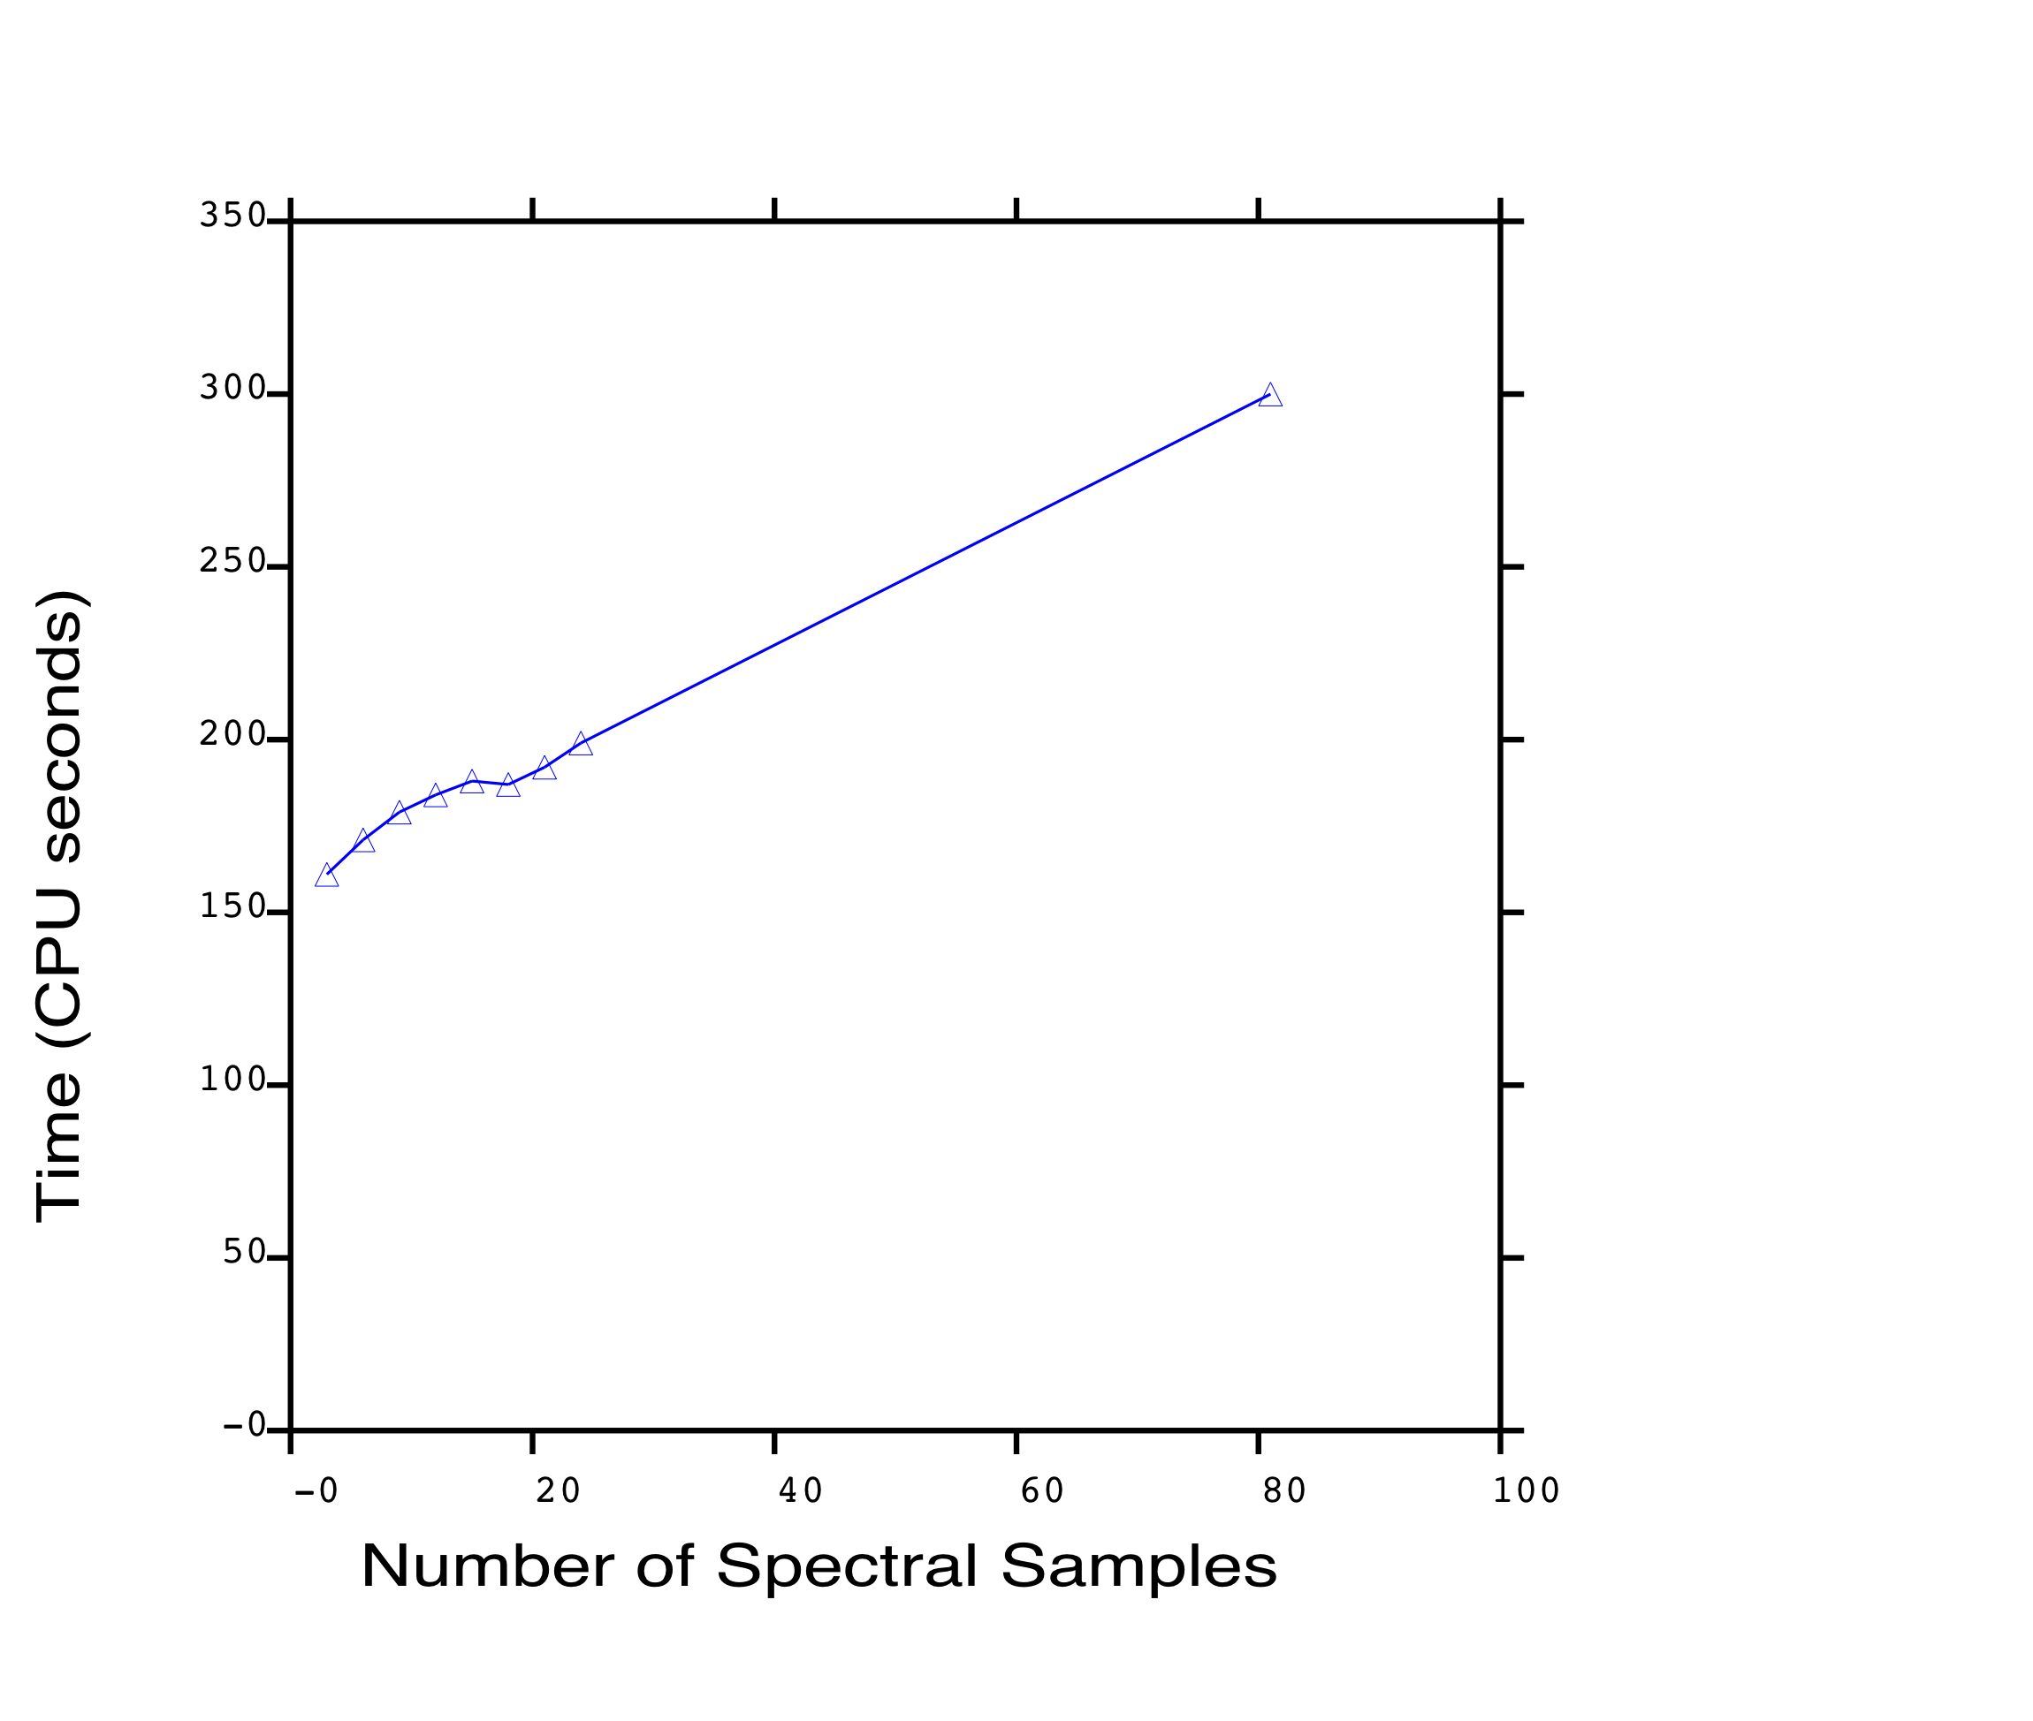
Rendering Time for Different Spectral Sample Densities

Slide 34
Photopic Luminance

Slide 35
Melanopic Luminance (from 24 spectral samples)

Slide 36
Melanopic Luminance (estimated from RGB)

Slide 37
Relative Error from Using RGB Estimate
-25%
0
+25%

Slide 38
Points for Discussion
Improvement levels off around 18 samples, at least for this scene
Benefits of RGB color space over straight spectral rendering means we don’t see advantage until 9 samples
Better selection of RGB primaries leads to more accurate results (EGWR ‘02)
Extending beyond visible limits?

Slide 39
Error from Rendering in RGB

Slide 40
Using Sharpened RGB Space

Slide 41
Extending Spectral Bounds
380-780 nm is used for most situations
Extending to NIR works OK, but far infrared of ~3000-100000 nm is issue for uniform wavelength steps
Uniform steps in frequency would make more sense, but conflicts with current measurement conventions

Slide 42
Future Work (1)
Further testing is needed (from you)
6.0a installers available from GitHub
Photon-mapping is currently broken with spectral rendering turned on
waiting on Roland Schregle to update it
May add HSR output to rpict at some point, but this faces challenges
image plane sampling is main problem

Slide 43
Future Work (2)
Holly Rushmeier has NSF grant to look at sharing information, code for hyperspectral rendering
Taoning Wang and other researchers are working on spectral sky models
Need to make changes/additions to annual simulation methods for multi-spectral (gendaylit, gendaymtx, etc.)

Slide 44
Conclusions
New spectral sampling can improve accuracy for some situations
includes support for melanopic response
Much work remains on the data side
sky models and measurements
materials, possibly BSDFs
Incorporating code into 3rd party tools and interfaces

